Slide 1

CS 332 Artificial Intelligence
School of Computer Engineering AND TECHNOLOGY

Slide 2

CS 332 Artificial Intelligence
Teaching Scheme Credits: 2 + 1 = 3
Theory: 4 Hrs / Week Practical: 2 Hrs / Week
Course Objectives:
To understand the concept of Artificial Intelligence (AI)
To learn various peculiar search strategies for AI
To develop a mind to solve real world problems unconventionally with optimality
Course Outcomes:
Identify and apply suitable Intelligent agents for various AI applications
Design smart system using different informed search / uninformed search or heuristic approaches.
Identify knowledge associated and represent it by ontological engineering to plan a strategy to solve given problem.

Slide 3
Syllabus
Knowledge Inference and Expert System
Basics of Probability, Markov Model, Statistical reasoning, Bayes' Theorem and its use, Bayesian learning and network
Expert systems: Architecture of Expert system, Role of Expert system, Inference engine, Knowledge acquisition, Typical Expert systems- MYCIN, Expert systems shells, Applications of Expert systems.

Slide 4
Knowledge Inference and Expert Systems

Slide 5
Contents
Basics of Probability,
Markov Model,
Statistical reasoning,
Bayes' Theorem and its use, Bayesian learning and network
Architecture of Expert system, Role of Expert system,
Inference engine, Knowledge acquisition,
Typical Expert systems- MYCIN, Expert systems shells,
Applications of Expert systems.

Slide 6
Acting under uncertainty
A logical agent uses propositions that are true, false or unknown
When the logical agent knows enough facts about it environment it derives plans that are guaranteed to work.
Unfortunately, agents almost never have access to the whole truth about their environment and therefore agents must act under uncertainty

Slide 7
Uncertainty
Let action A_{t} = leave for airport t minutes before flight . Will A_{t} get me there on time?
Problems:
partial observability (road state, other drivers' plans, noisy sensors)
uncertainty in action outcomes (flat tire, etc.)
immense complexity of modeling and predicting traffic
Hence a purely logical approach either
risks falsehood: “A₂₅ will get me there on time”, or
leads to conclusions that are too weak for decision making:
“A₂₅ will get me there on time if there's no accident on the bridge and it doesn't rain and my tires remain intact etc etc.” (A₁₄₄₀ might reasonably be said to get me there on time but I'd have to stay overnight in the airport …)

Slide 8
Probability to the Rescue
Probability
Model agent's degree of belief, given the available evidence.
A₂₅ will get me there on time with probability 0.04
Probability in AI models our ignorance, not the true state of the
world.
The statement “With probability 0.7 I have a cavity” means:
I either have a cavity or not, but I don’t have all the necessary
information to know this for sure.

Slide 9
Probability
All probability statements must indicate the evidence with respect to which the probability is being assessed
As agent receives new percepts, the probability assessments are updated to reflect new evidence
Before the evidence is obtained , we have prior or unconditional probability
After the evidence is obtained, we have posterior or conditional probability
Generally, the agent will have some evidence from its percepts and will be interested in computing the posterior probabilities of the outcomes it cares about

Slide 10
Probability
Subjective probability:
Probabilities relate propositions to agent's own state of knowledge
e.g., P(A₂₅ | no reported accidents at 3 a.m. ) = 0.06
Probabilities of propositions change with new evidence:
e.g., P(A₂₅ | no reported accidents at 5 a.m.) = 0.15

Slide 11
Making decisions under uncertainty
Suppose I believe the following:
P(A₂₅ gets me there on time | …) = 0.04
P(A₉₀ gets me there on time | …) = 0.70
P(A₁₂₀ gets me there on time | …) = 0.95
P(A₁₄₄₀ gets me there on time | …) = 0.9999
Which action to choose?
Depends on my preferences for missing flight vs. time spent waiting, etc.
Utility theory is used to represent and infer preferences
Decision theory = probability theory + utility theory

Slide 12
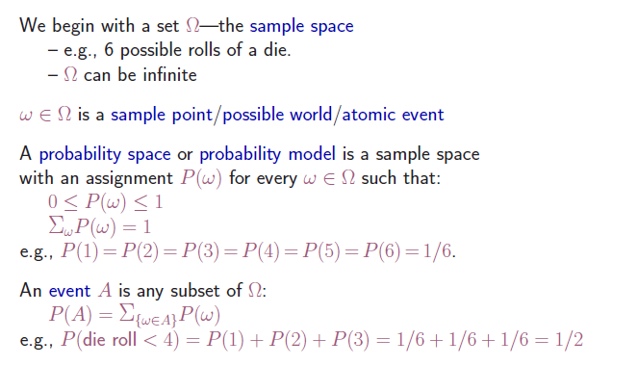
Probability Basics

Slide 13
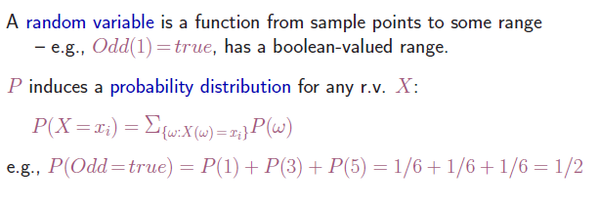
Probability Basics

Slide 14
Probability Basics
Capital letter: random variable
lower case: single value
Basic element: random variable
Similar to propositional logic: possible worlds defined by assignment of values to random variables.
Boolean random variables
e.g., Cavity (do I have a cavity?)
Discrete random variables
e.g., Weather is one of <sunny,rainy,cloudy,snow>
Elementary proposition constructed by assignment of a value to a random variable: e.g., Weather = sunny, Cavity = false (abbreviated as ¬cavity)
Complex propositions formed from elementary propositions and standard logical connectives e.g., Weather = sunny ∨ Cavity = false

Slide 15
Syntax
Atomic event: A complete specification of the state of the world about which the agent is uncertain (i.e. a full assignment of values to all variables in the universe, a unique single world).
E.g., if the world consists of only two Boolean variables Cavity and Toothache, then there are 4 distinct atomic events:
Cavity = false ∧ Toothache = false
Cavity = false ∧ Toothache = true
Cavity = true ∧ Toothache = false
Cavity = true ∧ Toothache = true
Atomic events are mutually exclusive and the set of all possible atomic events is exhaustive
if some atomic event is true,
then all other other atomic
events are false.
There is always some atomic event true.
Hence, there is exactly 1 atomic event true.

Slide 16
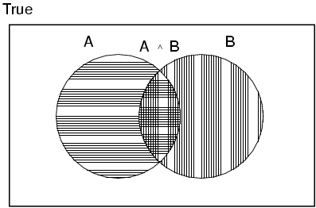
Axioms of probability
For any propositions A, B
0 ≤ P(A) ≤ 1
P(true) = 1 and P(false) = 0
P(A ∨ B) = P(A) + P(B) - P(A ∧ B)
true in all worlds e.g. P(a OR NOT(a))
false in all worlds: P(a AND NOT(a))
Think of P(A) as the number of worlds
in which A is true divided by the total number
of possible worlds.

Slide 17
Prior probability
Prior or unconditional probabilities of propositions
e.g., P(Cavity = true) = 0.1 and P(Weather = sunny) = 0.72 correspond to belief prior to arrival of any (new) evidence
Probability distribution gives values for all possible assignments:
P(Weather) = <0.72,0.1,0.08,0.1> (normalized, i.e., sums to 1)
Joint probability distribution for a set of random variables gives the probability of every atomic event of those random variables
P(Weather,Cavity) = a 4 × 2 matrix of values:
Weather = sunny rainy cloudy snow
Cavity = true 0.144 0.02 0.016 0.02
Cavity = false 0.576 0.08 0.064 0.08
Every question about a domain can be answered by the joint distribution

Slide 18
Conditional probability
Conditional or posterior probabilities
e.g., P(cavity | toothache) = 0.8 i.e., given that Toothache=true is all I know.
Note that P(Cavity|Toothache) is a 2x2 array, normalized over columns.
If we know more, e.g., cavity is also given, then we have
P(cavity | toothache,cavity) = 1
New evidence may be irrelevant, allowing simplification, e.g.,
P(cavity | toothache, sunny) = P(cavity | toothache) = 0.8

Slide 19
Conditional probability
Definition of conditional probability:
P(a | b) = P(a ∧ b) / P(b) if P(b) > 0
Product rule gives an alternative formulation:
P(a ∧ b) = P(a | b) P(b) = P(b | a) P(a)
Bayes Rule: P(a|b) = P(b|a) P(a) / P(b)
A general version holds for whole distributions, e.g.,
P(Weather,Cavity) = P(Weather | Cavity) P(Cavity)
(View as a set of 4 × 2 equations, not matrix multiplication)
Chain rule is derived by successive application of product rule:
P(X₁, …,X_{n}) = P(X₁,...,X_{n-1}) P(X_{n} | X₁,...,X_{n-1})
= P(X₁,...,X_{n-2}) P(X_{n-1} | X₁,...,X_{n-2}) P(X_{n} | X₁,...,X_{n-1})
= …
= π_{i= 1}^n P(X_{i} | X₁, … ,X_{i-1})

Slide 20

Inference by enumeration
Start with the joint probability distribution:
For any proposition a, sum the atomic events where it is true: P(a) = Σ_{ω s.t. a=true} P(ω)
P(a)=1/7 + 1/7 + 1/7 = 3/7

Slide 21

Inference by enumeration
Start with the joint probability distribution:
For any proposition a, sum the atomic events where it is true: P(a) = Σ_{ω:ω s.t. a=true} P(ω)
P(toothache) = 0.108 + 0.012 + 0.016 + 0.064 = 0.2

Slide 22

Inference by enumeration
Start with the joint probability distribution:
Can also compute conditional probabilities:
P(¬cavity | toothache) = P(¬cavity ∧ toothache) / P(toothache)
= (0.016+0.064 ) / (0.108 + 0.012 + 0.016 + 0.064)
= 0.4
Calculate (i) P(cavity) (ii) P(cavity | toothache)

Slide 23
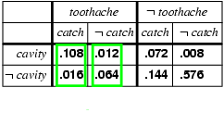
Inference by enumeration
Denominator can be viewed as a normalization constant α
P(Cavity | toothache) = α x P(Cavity,toothache)
= α x [P(Cavity,toothache,catch) + P(Cavity,toothache,¬ catch)]
= α x [<0.108,0.016> + <0.012,0.064>]
= α x <0.12,0.08> = <0.6,0.4>
General idea: compute distribution on query variable by fixing evidence variables and summing over hidden variables

Slide 24
Inference by enumeration
Typically, we are interested in
the posterior joint distribution of the query variables Y
given specific values e for the evidence variables E
Let the hidden variables be H = X - Y - E
Then the required summation of joint entries is done by summing out the hidden variables:
P(Y | E = e) = αP(Y,E = e) = αΣ_{h}P(Y,E= e, H = h)
The terms in the summation are joint entries because Y, E and H together exhaust the set of random variables
Obvious problems:
Worst-case time complexity O(d^{n}) where d is the largest arity
Space complexity O(d^{n}) to store the joint distribution
How to find the numbers for O(d^{n}) entries

Slide 25
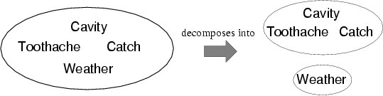
Independence
A and B are independent iff P(A|B) = P(A) or P(B|A) = P(B) or P(A, B) = P(A) P(B)
P(Toothache, Catch, Cavity, Weather)
= P(Toothache, Catch, Cavity) P(Weather)
32 entries reduced to 12;
for n independent biased coins, O(2^{n}) →O(n)
Absolute independence powerful but rare
Dentistry is a large field with hundreds of variables, none of which are independent. What to do?

Slide 26
Bayes' Rule
Product rule P(a∧b) = P(a | b) P(b) = P(b | a) P(a)
⇒ Bayes' rule: P(a | b) = P(b | a) P(a) / P(b)
or in distribution form
P(Y|X) = P(X|Y) P(Y) / P(X) = αP(X|Y) P(Y)
E.g., let m be meningitis, s be stiff neck: Let P(s | m)=0.8, P(m)=0.0001, P(s)=0.1
P(m|s) = P(s|m) P(m) / P(s) = 0.8 × 0.0001 / 0.1 = 0.0008
Note: even though the probability of having a stiff neck given meningitis is very large (0.8), the posterior probability of meningitis given a stiff neck is still very small
P(s|m) is more ‘robust’ than P(m|s). Imagine a new disease appeared
which would also cause a stiff neck, then P(m|s) changes but P(s|m) not.

Slide 27
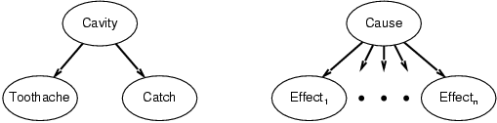
Bayes' Rule and conditional independence
This is an example of a naïve Bayes model:
P(Cause,Effect₁, … ,Effect_{n}) = P(Cause) π_{i}P(Effect_{i}|Cause)
Total number of parameters is linear in n
A naive Bayes classifier computes: P(cause|effect1, effect2...)

Slide 28
The Naive Bayes Classifier
Imagine we have access to the probabilities of
P(disease)
P(symptoms|disease)=P(headache|disease)P(backache|disease)....
Then, the probability of a disease is computed using Bayes rule:
P(disease|symptoms) = constant x P(symptoms|disease) x P(disease)

Slide 29
Learning a Naive Bayes Classifier
What to do if we only have observations from a doctors office?
For instance: flu1→ headache, fever, muscle ache
lungcancer1 → short breath, breast pain
flu2 → headache, fever, cough
....
In general {(x1,y1), (x2,y2), (x3,y3),....}
symptoms (attributes)
disease (label)
P(disease = y) = # people with disease y = fraction of people with disease y
total # of people in dataset
P(symptom_A=x_A|disease = y) = # people with disease y that have symptom A
total # people with disease y

Slide 30
Graphical Models
If no assumption of independence is made, then an exponential number of parameters must be estimated for sound probabilistic inference.
No realistic amount of training data is sufficient to estimate so many parameters.
If a blanket assumption of conditional independence is made, efficient training and inference is possible, but such a strong assumption is rarely warranted.
Graphical models use directed or undirected graphs over a set of random variables to explicitly specify variable dependencies and allow for less restrictive independence assumptions while limiting the number of parameters that must be estimated.
Bayesian Networks: Directed acyclic graphs that indicate causal structure.
Markov Networks: Undirected graphs that capture general dependencies.

Slide 31
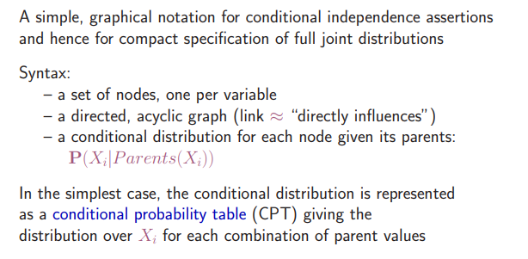
Bayesian network

Slide 32
Bayesian Networks
Directed Acyclic Graph (DAG)
Nodes are random variables
Edges indicate causal influences
Burglary
Earthquake
Alarm
JohnCalls
MaryCalls

Slide 33
Conditional Probability Tables
Each node has a conditional probability table (CPT) that gives the probability of each of its values given every possible combination of values for its parents (conditioning case).
Roots (sources) of the DAG that have no parents are given prior probabilities.
P(B)
.001
Burglary
Earthquake
P(E)
.002
B | E | P(A)
T | T | .95
T | F | .94
F | T | .29
F | F | .001
Alarm
A | P(J)
T | .90
F | .05
A | P(M)
T | .70
F | .01
JohnCalls
MaryCalls

Slide 34
Joint Distributions for Bayes Nets
A Bayesian Network implicitly defines a joint distribution.
Example
.

Slide 35
Naïve Bayes as a Bayes Net
Naïve Bayes is a simple Bayes Net
Y
…
X₁
X₂
X_{n}
Priors P(Y) and conditionals P(X_{i}|Y) for Naïve Bayes provide CPTs for the network.

Slide 36
WHAT IS A MARKOV MODEL?
A Markov Model is a stochastic model which models temporal or sequential data, i.e., data that are ordered.
It provides a way to model the dependencies of current information (e.g. weather) with previous information.
It is composed of states, transition scheme between states, and emission of outputs (discrete or continuous).
Several goals can be accomplished by using Markov models:
Learn statistics of sequential data.
Do prediction or estimation.
Recognize patterns.

Slide 37
Markov Model Example
Design a Markov Model to predict the weather of tomorrow using previous information of the past days.
Our model has only 3 states: 𝑆=𝑆1,𝑆2,𝑆3, and the name of each state is 𝑆1=𝑆𝑢𝑛𝑛𝑦, 𝑆2=𝑅𝑎𝑖𝑛𝑦, 𝑆3=𝐶𝑙𝑜𝑢𝑑𝑦.
To establish the transition probabilities relationship between states we will need to collect data.
Assume the data produces the following transition probabilities:

Slide 38
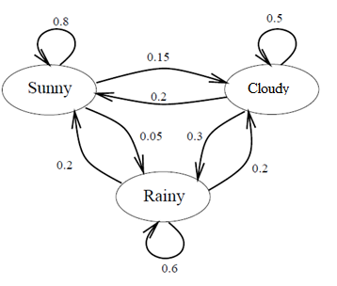
Markov model is represented by a graph with set of vertices
corresponding to the set of states Q and probability of going
from state i to state j is described by matrix
A which is n x n transition probability matrix
A(i,j)= P[q _{t+1}=j|q _{t} =i] where q t denotes state at time t
Thus Markov model M is described by set of states Q and a transition probability matrix A such that M = (Q, A)

Slide 39
Markov Models
𝑃(𝑆𝑢𝑛𝑛𝑦|𝑆𝑢𝑛𝑛𝑦)=0.8
𝑃(𝑅𝑎𝑖𝑛𝑦|𝑆𝑢𝑛𝑛𝑦)=0.05
𝑃(𝐶𝑙𝑜𝑢𝑑𝑦|𝑆𝑢𝑛𝑛𝑦)=0.15
𝑃(𝑆𝑢𝑛𝑛𝑦|𝑅𝑎𝑖𝑛𝑦)=0.2
𝑃(𝑅𝑎𝑖𝑛𝑦|𝑅𝑎𝑖𝑛𝑦)=0.6
𝑃(𝐶𝑙𝑜𝑢𝑑𝑦|𝑅𝑎𝑖𝑛𝑦)=0.2
𝑃(𝑆𝑢𝑛𝑛𝑦|𝐶𝑙𝑜𝑢𝑑𝑦)=0.2
𝑃(𝑅𝑎𝑖𝑛𝑦|𝐶𝑙𝑜𝑢𝑑𝑦)=0.3
𝑃(𝐶𝑙𝑜𝑢𝑑𝑦|𝐶𝑙𝑜𝑢𝑑𝑦)=0.5
q_{i-1}
 | Sunny | Rainy | Cloudy
Sunny | 0.8 | 0.2 | 0.2
Rainy | 0.05 | .6 | .3
Cloudy | 0.15 | 0.2 | 0.5
q_{i}

Slide 40

Markov Models
Let’s say we have a sequence: Sunny, Rainy, Cloudy, Cloudy, Sunny, Sunny, Sunny, Rainy, ….; so, in a day we can be in any of the three states.
We can use the following state sequence notation:
𝑞1, 𝑞2, 𝑞3, 𝑞4, 𝑞5,.., where 𝑞𝑖 𝜖 {𝑆𝑢𝑛𝑛𝑦,𝑅𝑎𝑖𝑛𝑦,𝐶𝑙𝑜𝑢𝑑𝑦}.
In order to compute the probability of tomorrow’s weather we can use the Markov property:

Slide 41
Markov Property
So, what is Markov property
The probability of being in a specific state at a future time t only depends ONLY on the state of the system right now (s) state, and NOT at all about the states the system has had before (before s).
A “memorylessness” process, where the next state of the process depends only on the previous state and not the sequence of states.

Slide 42
Markov Models
Exercise 1: Given that today is Sunny, what’s the probability that tomorrow is Sunny and the next day Rainy?
𝑃(𝑞₂,𝑞₃|𝑞₁)=𝑃(𝑞₂ | 𝑞₁) 𝑃(𝑞₃ | 𝑞₁,𝑞₂)
= 𝑃(𝑞₂|𝑞₁) 𝑃(𝑞₃ | 𝑞₂ )
= 𝑃(𝑆𝑢𝑛𝑛𝑦 | 𝑆𝑢𝑛𝑛𝑦) 𝑃(𝑅𝑎𝑖𝑛𝑦 |𝑆𝑢𝑛𝑛𝑦 )
=0.8(0.05)
=0.04
Exercise 2: Assume that yesterday’s weather was Rainy, and today is Cloudy, what is the probability that tomorrow will be Sunny?

Slide 43
Expert System
Attempt to model expert decision making in a limited domain
Examples: medical diagnosis, computer configuration, machine fault diagnosis
Requires a willing Expert
Requires knowledge representable as rules
Doesn’t work for chess
Preponderance of evidence for decision, not proof. (Civil law suits)

Slide 44
Rule Based System
What is a Rule Based System? Rule based system or knowledge based systems are specialized software that encapsulate ‘Human Intelligence’ like knowledge there by make intelligent decisions quickly and in repeatable form
Rule-based systems (RBS) provide automatic problem solving tools for capturing the human expertise and decision making.

Slide 45
Some of the RBS application areas are:
Equipment maintenance - diagnosing faults and recommending repairs
Component selection - eliciting requirements from electronics catalogs
Computer operation - analyzing requirements, and operating software
Product configuration - identifying parts that satisfy constraints
Troubleshooting - suggesting treatments, and prescribing preventative measures
Process control - spotting problematic data and removing irregularities
Quality assurance - assessing tasks, proposing practices
medical diagnosis

Slide 46
RBS has two distinguishing characteristics:
The existing knowledge can be refined and new knowledge can be added for incremental increase of the system performance.
They explain the line of reasoning making their logic transparent.

Slide 47
Properties of rule-based systems
They incorporate practical human knowledge in if-then rules.
Their skill increases proportionally to the enlargement of the knowledge.
They can solve a wide range of potentially complex problems by selecting relevant rules and then combining the results.
They adaptively determine the best sequence of rules to examine.
They explain their conclusions by retracting their lines of reasoning.

Slide 48
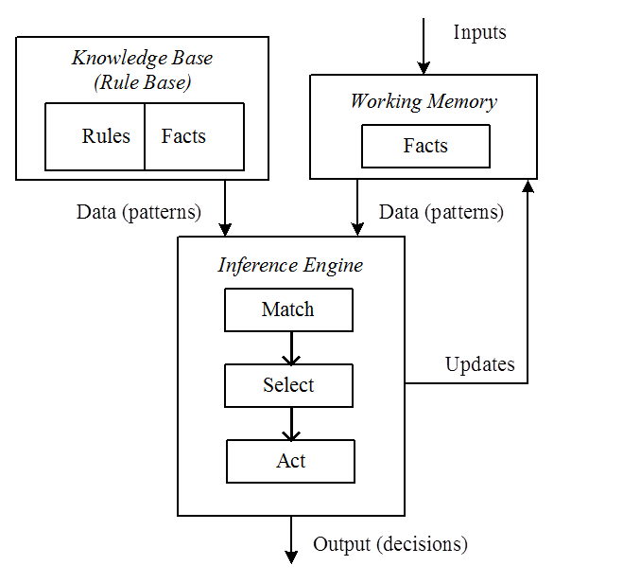
Architecture of RBS

Slide 49
Continued…
An RBS consists of a knowledge base and an inference engine.
The knowledge base contains rules and facts.
Rules
The rules contain several if-patterns (antecedents) and one or more then-patterns (consequents).
The interpretation of a rule is that if the antecedent can be satisfied then the consequent is satisfied too.
When the consequent defines an action the effect of satisfying the antecedent is to schedule the action for execution. When the consequent defines a conclusion the effect is to infer the conclusion.
The rules specify chunks of analytic problem-solving knowledge. They use symbolic descriptions to characterize relevant situations and corresponding actions. The language used for these descriptions imposes a conceptual framework on the problem and its solutions.

Slide 50
Facts
The facts express assertions about properties, relations, propositions, etc. In contrast to rules which the RBS interprets as imperatives, facts are usually static and inactive regarding the programmatic value of knowledge.
Working Memory
The knowledge base that contains the rules is long-term store.
In addition to this static memory, the RBS uses a working memory
(short-term store) to store temporary assertions.
These assertions record earlier rule-based inferences, thus the
contents of the working memory is problem-solving state information.
The working memory data adhere to the syntactic conventions for facts.

Slide 51
Inference Engine
The basic function of the RBS is to produce outputs, which may be a problem solution, an answer to a question, or an analysis of some data.
The main operating cycle of RBS consists of three phases:
match, select and act.
When certain triggering (firing) conditions occur the actions specified by the rules are executed. The firing conditions are defined by the data patterns in the working memory.
When the patterns in a rule are matched, the system selects this rule and interprets it so as to draw inferences that alter the working memory.
The most common RBS modes of operation are:
- forward chaining (stimulus driven)
- backward chaining (goal directed)

Slide 52
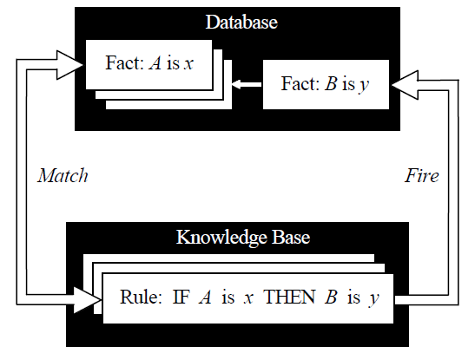
Inference engine cycles via a match-fire procedure

Slide 53
Inferencing
Given a set of rules like these, there are essentially two ways we can use them to generate new knowledge:
forward chaining: starts with the facts, and sees what rules apply (and hence what should be done) given the facts. data driven;
2. backward chaining : starts with something to find out, and
looks for rules that will help in answering it goal driven.

Slide 54
In a forward chaining system: Facts are held in a working memory Condition-action rules represent actions to take when specified facts occur in working memory.
Typically the actions involve adding or deleting facts from working memory.

Slide 55
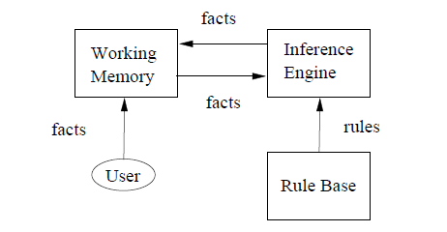

Slide 56
Forward Chaining : Forward chaining mode of operation means that a rule is triggered when changes in the working memory produce a situation that matches all of its antecedents.
Forward chaining is the process of inferring then-patterns from if-patterns, that is consequents from antecedents. When an antecedent matches an assertion the antecedent is satisfied.
When all antecedents of a rule are satisfied the rule is triggered. In deduction systems all triggered rules are allowed and may fire.

Slide 57
Forward Chaining Algorithm
Repeat
For each rule do
Match all its antecedents to the facts from the Working memory
- if all antecedents of a rule are matched,
Execute is consequents
until no rule produces a new assertion, or the goal is satisfied

Slide 58
Example: A deduction system for identification of animals:
(RULE 1 (IF ( ?x has hair ))
(THEN ( ?x is mammal )))
(RULE 2 (IF ( ?x gives milk ))
(THEN ( ?x is mammal )))
(RULE 3 (IF ( ?x has feathers ))
(THEN ( ?x is bird )))
(RULE 4 (IF ( ?x flies )&( ?x lays eggs ))
(THEN ( ?x is bird )))
(RULE 5 (IF ( ?x is mammal )&( ?x eats meat ))
(THEN ( ?x is carnivore )))

Slide 59
Forward Chaining Example
Facts:
F1: Ungee gives milk
F2: Ungee eats meat
F3: Ungee has hoofs
Rules:
R1: If X gives milk, then it is a mammal
R2: If X is a mammal and eats meat, then carnivore.
R3: If X is a carnivore and has hoofs, then ungulate
Easy to see: Ungee is ungulate.

Slide 60
Backward Chaining
The backward chaining mode of operation means that the systems begins with a goal and successively examines any rules with matching consequents. These candidate rules are considered one at a time.
The unmet conditions are in turn reintroduced as new goals. The control procedure then shifts attention recursively toward the new goal. The effort terminates when the top goal is finally satisfied.

Slide 61
Backward Chaining Algorithm
Repeat
For each hypothesis do
For each rule whose consequent matches this hypothesis
- try to Match each of the rule antecedents with the
facts from the working memory, or using backward chaining through another rule, thus, creating new hypotheses
- if all of the rule antecedents are supported then success
until all hypotheses have been tried, and none have been supported,
or until the goal is satisfied

Slide 62
Backward Chaining
Start with Goal G1: is Ungee an ungulate?
G1 matches conclusion of R3
Sets up premises as subgoals
G2: Ungee is carnivore
G3: Ungee has hoofs
G3 matches fact F3 so true.
G2 matches conclusion of R2. etc.

Slide 63
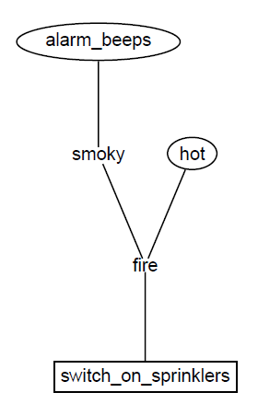
Example
Rules:
R1: IF hot AND smoky THEN fire
R2: IF alarm_beeps THEN smoky
R3: If fire THEN switch_on_sprinklers
Facts:
F1: hot
F2: alarm_beeps
Goal:
Should I switch sprinklers on?

Slide 64
Rule Based Expert System
Knowledge is a theoretical or practical understanding of a subject or a domain. Knowledge is also the sum of what is currently known, and apparently knowledge is power. Those who possess knowledge are called experts.
Anyone can be considered a domain expert if he or she has deep knowledge (of both facts and rules) and strong practical experience in a particular domain. The area of the domain may be limited. In general, an expert is a skillful person who can do things other people cannot.

Slide 65
The human mental process is internal, and it is too complex to be represented as an algorithm.
However, most experts are capable of expressing their knowledge in the form of rules for problem solving.
IF the ‘traffic light’ is green
THEN the action is go
IF the ‘traffic light’ is red
THEN the action is stop

Slide 66
Rules as a knowledge representation technique
The term rule in AI, which is the most commonly used type of knowledge representation, can be defined as an IF-THEN structure that relates given information or facts in the IF part to some action in the THEN part. A rule provides some description of how to solve a problem. Rules are relatively easy to create and understand.
Any rule consists of two parts: the IF part, called
the antecedent (premise or condition) and the THEN part
called the consequent (conclusion or action).

Slide 67
IF <antecedent>
THEN <consequent>
A rule can have multiple antecedents joined by the keywords AND (conjunction), OR (disjunction) or a combination of both.
IF <antecedent 1> IF <antecedent 1>
AND <an t e .cedent 2> OR <a n t e.cedent 2> .... ....
AND <antecedent n> OR <antecedent n>
THEN <consequent> THEN <consequent>

Slide 68
The main players in the development team
There are five members of the expert system
development team:
the domain expert,
the knowledge engineer,
the programmer,
The project manager and the end-user.
The success of their expert system entirely depends on how well the members work together.

Slide 69
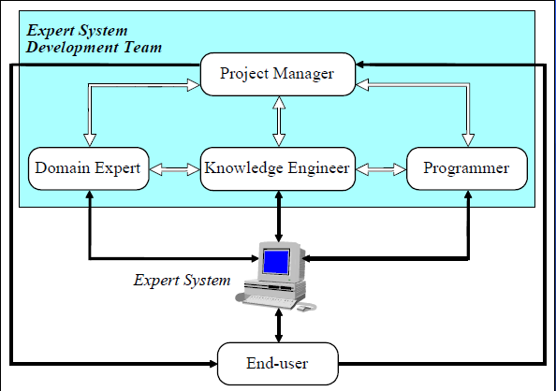
The main players in the development team

Slide 70
The domain expert is a knowledgeable and skilled person capable of solving problems in a specific area or domain. This person has the greatest expertise in a given domain. This expertise is to be captured in the expert system. Therefore, the expert must be able to communicate his or her knowledge, be willing to participate in the expert system development and commit a substantial amount of time to the project. The domain expert is the most important player in the expert system development team.

Slide 71
The knowledge engineer is someone who is capable of designing, building and testing an expert system. He or she interviews the domain expert to find out how a particular problem is solved. The knowledge engineer establishes what reasoning methods the expert uses to handle facts and rules and decides how to represent them in the expert system. The knowledge engineer then chooses some development software or an expert system shell, or looks at programming languages for encoding the knowledge. And finally, the knowledge engineer is responsible for testing, revising and integrating the expert system into the workplace.

Slide 72
The programmer is the person responsible for the actual programming, describing the domain knowledge in terms that a computer can understand. The programmer needs to have skills in symbolic programming in such AI languages as LISP, Prolog and OPS5 and also some experience in the application of different types of expert system shells. In addition, the programmer should know conventional programming languages like C, Pascal, FORTRAN and Basic.

Slide 73
The project manager is the leader of the expert system development team, responsible for keeping the project on track. He or she makes sure that all deliverables and milestones are met, interacts with the expert, knowledge engineer, programmer and end-user.
The end-user, often called just the user, is a person who uses the expert system when it is developed. The user must not only be confident in the expert system performance but also feel comfortable using it. Therefore, the design of the user interface of the expert system is also vital for the project’s success;
the end-user’s contribution here can be crucial.

Slide 74
Structure of a rule-based expert system
In the early seventies, Newell and Simon from Carnegie-Mellon University proposed a production system model, the foundation of the modern rulebased expert systems.
The production model is based on the idea that humans solve problems by applying their knowledge (expressed as production rules) to a given problem represented by problem-specific information.
The production rules are stored in the long-term memory and the problem-specific information or facts in the short-term memory.

Slide 75
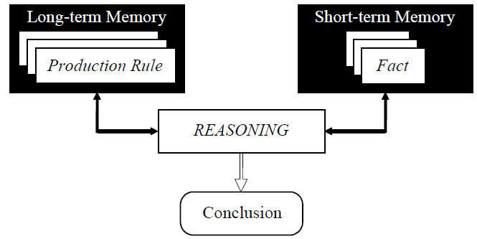
Production system model

Slide 76
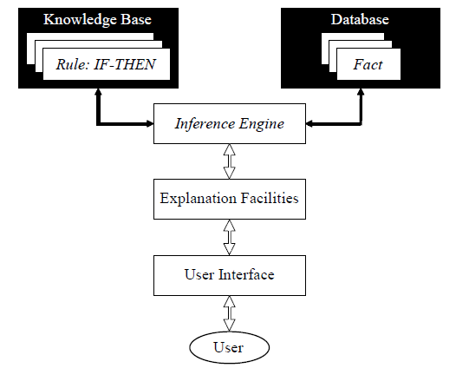
Basic structure of a rule-based expert system

Slide 77
The knowledge base contains the domain knowledge useful for problem solving. In a rule based expert system, the knowledge is represented as a set of rules. Each rule specifies a relation, recommendation, directive, strategy or heuristic and has the IF (condition) THEN (action) structure. When the condition part of a rule is satisfied, the rule is said to fire and the action part is executed.
The database includes a set of facts used to match against the IF (condition) parts of rules stored in the knowledge base.

Slide 78
The inference engine carries out the reasoning whereby the expert system reaches a solution. It links the rules given in the knowledge base with the facts provided in the database.
The explanation facilities enable the user to ask the expert system how a particular conclusion is reached and why a specific fact is needed. An expert system must be able to explain its reasoning and justify its advice, analysis or conclusion.
The user interface is the means of communication between a user seeking a solution to the problem and an expert system.

Slide 79
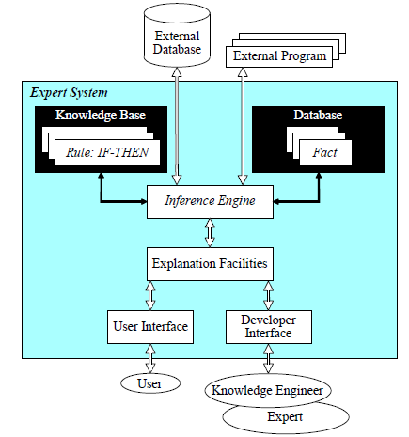
Complete structure of a rule-based expert system

Slide 80
Characteristics of an expert system
An expert system is built to perform at a human expert level in a narrow, specialized domain. Thus, the most important characteristic of an expert system is its high-quality performance. No matter how fast the system can solve a problem, the user will not be satisfied if the result is wrong.
On the other hand, the speed of reaching a solution is very important. Even the most accurate decision or diagnosis may not be useful if it is too late to apply, for instance, in an emergency, when a patient dies or a nuclear power plant explodes.

Slide 81
Expert systems apply heuristics to guide the reasoning and thus reduce the search area for a solution.
A unique feature of an expert system is its explanation capability. It enables the expert system to review its own reasoning and explain its decisions.
Expert systems employ symbolic reasoning when solving a problem. Symbols are used to represent different types of knowledge such as facts, concepts and rules.

Slide 82
Components of an ES
Knowledge Base
Reasoning or Inference Engine
User Interface
Explanation Facility

Slide 83
User Interface
Allows the expert system and the user to communicate.
Finds out what it is that the system needs to answer.
Sends the user questions or answers and receives their response.

Slide 84
Explanation Facility
Explains the systems reasoning and justifies its conclusions.

Slide 85
Knowledge Base
Represents all the data and information imputed by experts in the field.
Stores the data as a set of rules that the system must follow to make decisions.

Slide 86
Inference Engine
Asks the user questions about what they are looking for.
Applies the knowledge and the rules held in the knowledge base.
Appropriately uses this information to arrive at a decision.

Slide 87
Advantages of rule-based expert systems
Natural knowledge representation. An expert usually explains the problem-solving procedure with such expressions as this: “In such-and-such situation, I do so-and-so”. These expressions can be represented quite naturally as IF-THEN production rules.
Uniform structure. Production rules have the uniform IF-THEN structure. Each rule is an independent piece of knowledge. The very syntax of production rules enables them to be self documented.

Slide 88
Separation of knowledge from its processing.
The structure of a rule-based expert system provides an effective separation of the knowledge base from the inference engine. This makes it possible to develop different applications using the same expert system shell.
Dealing with incomplete and uncertain knowledge.
Most rule-based expert systems are capable of representing and reasoning with incomplete and uncertain knowledge

Slide 89
Disadvantages of rule-based expert systems
Opaque relations between rules. Although the individual production rules are relatively simple and self-documented, their logical interactions within the large set of rules may be opaque. Rule-based systems make it difficult to observe how individual rules serve the overall strategy.
Ineffective search strategy. The inference engine applies an exhaustive search through all the production rules during each cycle. Expert systems with a large set of rules (over 100 rules) can be slow, and thus large rule-based systems can be unsuitable for real-time applications.

Slide 90
Inability to learn. In general, rule-based expert systems do not have an ability to learn from the experience. Unlike a human expert, who knows when to “break the rules”, an expert system cannot automatically modify its knowledge base, or adjust existing rules or add new ones. The knowledge engineer is still responsible for revising and maintaining the system.

Slide 91
MYCIN
History and Overview
MYCIN Architecture
Consultation System
Knowledge Representation & Reasoning
Explanation System
Knowledge Acquisition
Results, Conclusions

Slide 92
History
Thesis Project by Shortliffe @ Stanford
Davis, Buchanan, van Melle, and others
Stanford Heuristic Programming Project
Infectious Disease Group, Stanford Medical
Project Spans a Decade
Research started in 1972
Original implementation completed 1976
Research continues into the 80’s

Slide 93
Tasks and Domain
Disease DIAGNOSIS and Therapy SELECTION
Advice for non-expert physicians with time considerations and incomplete evidence on:
Bacterial infections of the blood
Expanded to meningitis and other ailments

Slide 94
MYCIN Architecture

Slide 95
Consultation System
Performs Diagnosis and Therapy Selection
Control Structure reads Static DB (rules) and read/writes to Dynamic DB (patient, context)
Linked to Explanations
Terminal interface to Physician

Slide 96
Static Database
Rules
Meta-Rules
Templates
Rule Properties
Context Properties
Fed from Knowledge Acquisition System

Slide 97
Dynamic Database
Patient Data
Laboratory Data
Context Tree
Built by Consultation System
Used by Explanation System

Slide 98
Context Tree

Slide 99
Explanation System
Provides reasoning why a conclusion has been made, or why a question is being asked
Q-A Module
Reasoning Status Checker

Slide 100
Knowledge Acquisition System
Extends Static DB via Dialogue with Experts
Dialogue Driven by System
Requires minimal training for Experts
Allows for Incremental Competence, NOT an All-or-Nothing model

Slide 101
Knowledge Acquisition
IF-THEN Symbolic logic was found to be easy for experts to learn, and required little training by the MYCIN team
When faced with a rule, the expert must either except it or be forced to update it using the education process

Slide 102
Education Process
Bug is uncovered, usually by Explanation process
Add/Modify rules using subset of English by experts
Integrating new knowledge into KB
Found to be difficult in practice, requires detection of contradictions, and complex concepts become difficult to express

